Slide 1
Decision Trees

Slide 2
Overview
What is the Decision Tree Algorithm?
Structure of Decision Trees
Criteria for attribute selection
Advantages and Disadvantages of Decision Trees

Slide 3
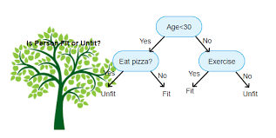
What is the Decision Tree Algorithm
Supervised learning algorithm.
It can be used for both regression and classification.
Predicts classes or values by learning decision rules from training data.
Types: Categorical Variable Decision Tree and Continuous Variable Decision Tree

Slide 4
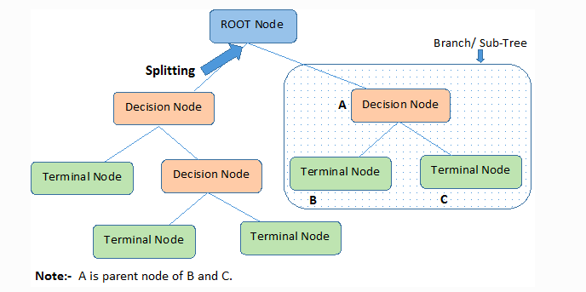
Structure of Decision Trees

Slide 5
Criteria for Attribute Selection
The main challenge with implementing a decision tree algorithm is deciding on which attributes to use as the root node and each level of the tree.
Three main criteria used to determine this:
Entropy
Information Gain
Gini Index

Slide 6
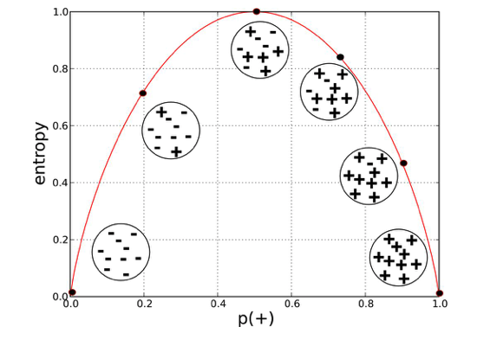

Entropy
A measure of randomness, purity or disorder in the information being presented.
Higher values or entropy means there’s a higher level of impurity.
Lower values of entropy are more acceptable since the goal of machine learning is to reduce uncertainty.
Hence, a branch with an entropy of zero is a leaf node and a branch with entropy more than zero needs further splitting
Mathematically, entropy is represented as:

Slide 7

Information Gain
It measures how well a given attribute separates the training examples according to their target classification.
Information gain is a decrease in entropy. It computes the difference between entropy before split(parent node) and average entropy after split(child nodes) of the dataset based on given attribute values.

Slide 8
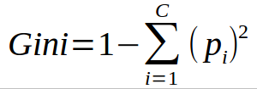
Gini Index
The Gini Index is calculated by subtracting the sum of the squared probabilities of each class from one.
Favors larger partitions and easy to implement, whereas information gain favors smaller partitions with distinct values.
It performs only binary splits.

Slide 9
Advantages and Disadvantages of Decision Tree
ADVANTAGES
DISADVANTAGES
Decision tree models are simpler to interpret.
Can handle both numerical and categorical data.
Decision trees require relatively little effort from users for data preparation.
Decision trees are prone to overfitting.

Slide 10
Ways to Avoid Overfitting of Decision Trees
Pruning
In pruning, you trim off the branches of the tree, i.e., remove the decision nodes starting from the leaf node such that the overall accuracy is not disturbed.
Random Forest
Random Forest is an example of ensemble learning, in which we combine multiple machine learning algorithms to obtain better predictive performance.

